Slide 1
Agile Methodology

Slide 2
What is Agile
Agile is a
set of principles that encourage flexibility,
adaptability,
communication and
working software over plans and processes.
Agile is a software development approach where a self-sufficient and cross-functional team works on making continuous deliveries through iterations and evolves throughout the process by gathering feedback from the end users.

Slide 3
Cross-functional teams
A cross-functional team is
a group of people with different functional expertise working toward a common goal.
It may include people from finance, marketing, operations, and human resources departments.
Typically, it includes employees from all levels of an organization

Slide 4
User Stories
A key component of agile software development is putting people first, and user-stories put actual end users at the center of the conversation. Stories use non-technical language to provide context for the development team and their efforts. After reading a user story, the team knows why they are building what they're building and what value it creates.
A user story is the smallest unit of work in an agile framework. It’s an end goal, not a feature, expressed from the software user’s perspective.

Slide 5
User Story Template and Examples
User stories are often expressed in a simple sentence, structured as follows:
“As a [persona], I [want to], [so that].”
For example, user stories might look like:
As Max, I want to invite my friends, so we can enjoy this service together.
As Sascha, I want to organize my work, so I can feel more in control.
As a manager, I want to be able to understand my colleagues progress, so I can better report our sucess and failures.

Slide 6
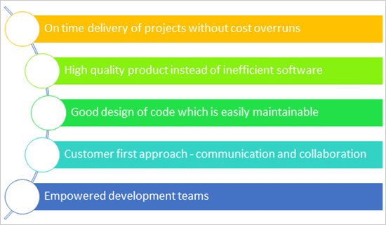
Agile Promises

Slide 7
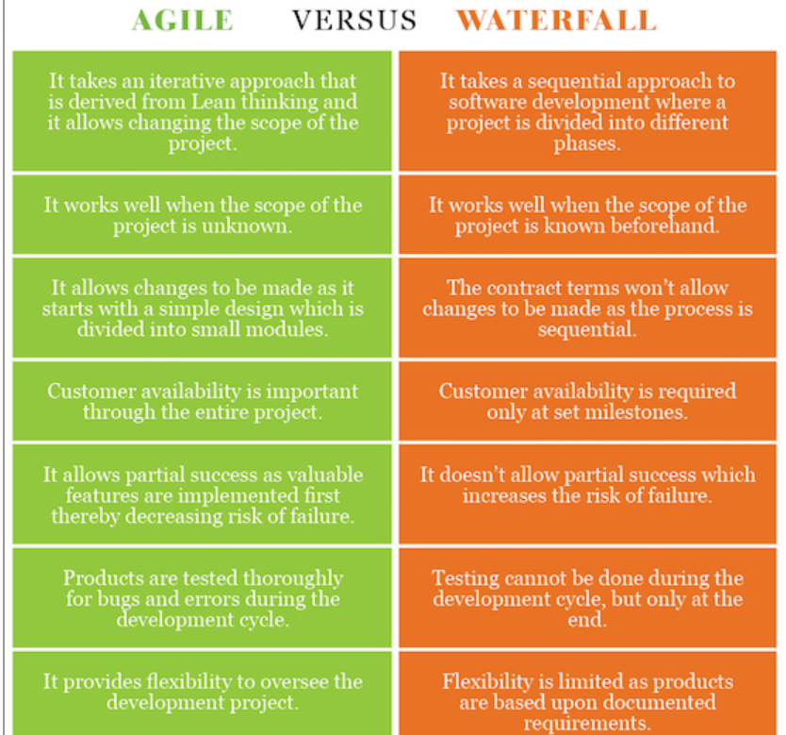

Slide 8
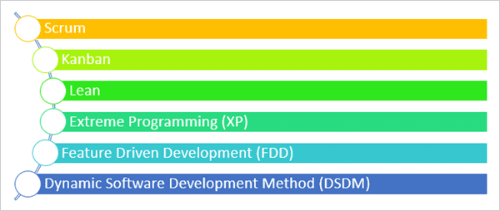
Types of Agile Methodologies

Slide 9
Scrum
Scrum is an agile process
for managing complex projects, especially software development that has dynamic and highly emergent requirements.
Scrum software development proceeds to its completion via a series of iterations called Sprint.
Small teams consisting of a 6-10 people (it may vary) divide their work into “mini projects (iterations)” that have duration of about one – four weeks during which a limited number of detailed user stories are done.

Slide 10
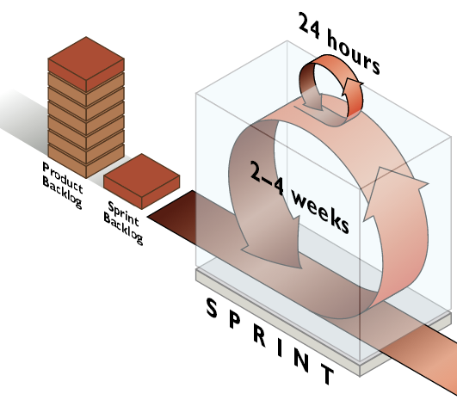
Scrum Methodology

Slide 11
A product backlog
A product backlog is a list of the new features, changes to existing features, bug fixes, infrastructure changes or other activities that a team may deliver in order to achieve a specific outcome.
The product backlog is the single authoritative source for things that a team works on.

Slide 12
Sprint Backlog
The sprint backlog is a list of tasks identified by the Scrum team to be completed during the Scrum sprint.
During the sprint planning meeting, the team selects some number of product backlog items, usually in the form of user stories, and identifies the tasks necessary to complete each user story.

Slide 13
Scrum
Daily Scrum: Daily scrum is the meeting where team members meet every day on a scheduled time to share updates to scrum master on the following things:
What did they do in their tasks since last meeting?
What are they planning to do before next daily scrum meeting?
Is there anything that is preventing them to do what they planned?
Note: Duration of this meeting is very short (15-20 minutes).

Slide 14
Roles of people in Scrum
Product Owner: Product owner represents the voice of the customer from a business perspective and creates a prioritized wish list of the user stories called a product backlog.
Product owner administers a product backlog – a current “To Do” list where all the functional specifications for a product are listed within the user story as acceptance criteria according to business perspective. So, we can also denote Product Owner as ‘Customer’.

Slide 15
Roles of people in Scrum
Scrum Master: The responsibility of scrum master is to arrange different meetings so that team members can meet with each other for different perspectives with the sprint tasks. Scrum master always aims at providing the team with the best possible circumstances for realizing the goals fixed for the sprint. He ensures that every team member has an appropriate task to do. We can call him coach of the team.

Slide 16
Roles of people in Scrum
The Scrum Team Members: Team members work on actual sub tasks/ bugs assigned to them. They resolve the sub tasks to make them “Done” and share their updates to scrum master.

Slide 17
UML
UML stands for Unified Modeling Language.
It’s a rich language to model software solutions, application structures, system behavior and business processes.

Slide 18
Use Case Diagram
Use case diagrams give a graphic overview of the actors involved in a system, different functions needed by those actors and how these different functions interact.

Slide 19
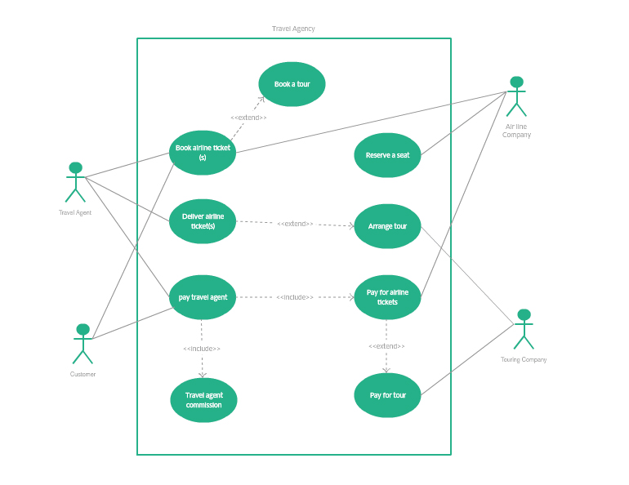

Slide 20
Class Diagram
Class diagrams are the main building block of any object-oriented solution. It shows the classes in a system, attributes, and operations of each class and the relationship between each class.

Slide 21
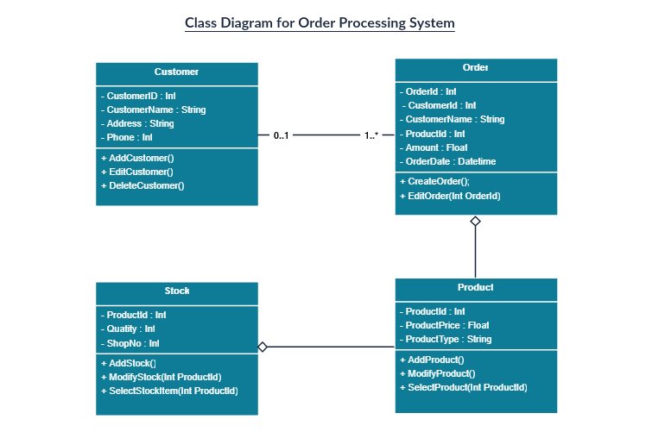

Slide 22
Object Diagram
Object Diagrams, sometimes referred to as Instance diagrams are very similar to class diagrams. Like class diagrams, they also show the relationship between objects but they use real-world examples.

Slide 23
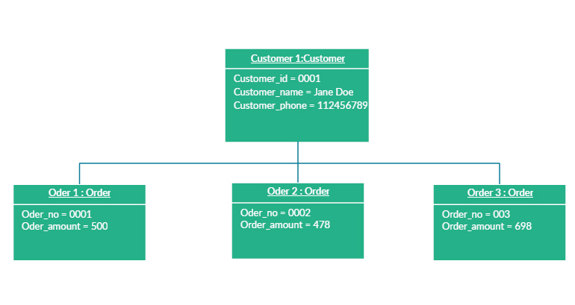

Slide 24
Sequence diagrams
Sequence diagrams in UML show how objects interact with each other and the order those interactions occur. It’s important to note that they show the interactions for a particular scenario. The processes are represented vertically and interactions are shown as arrows.

Slide 25
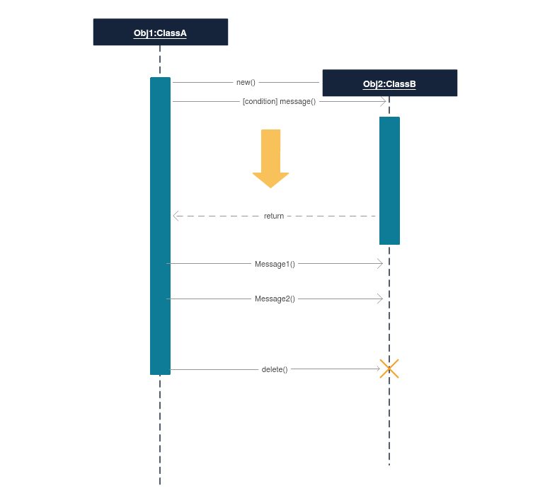

Slide 26
State machine diagrams
State machine diagrams are similar to activity diagrams, although notations and usage change a bit. They are sometimes known as state diagrams or state chart diagrams as well

Slide 27
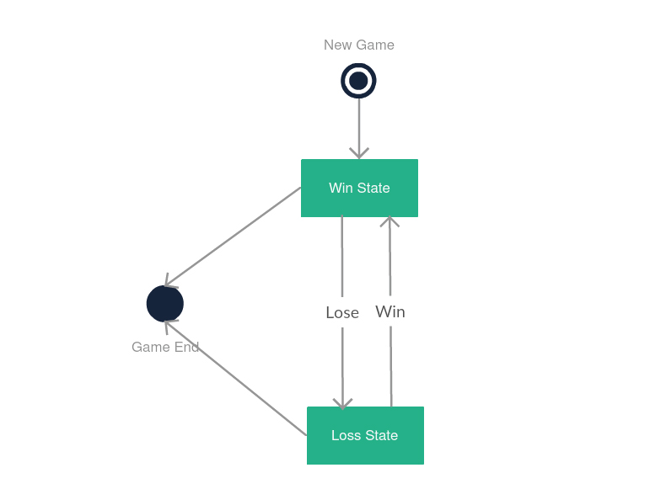

Slide 28
A collaboration diagram
A collaboration diagram, also known as a communication diagram, is an illustration of the relationships and interactions among software objects in the Unified Modeling Language (UML). These diagrams can be used to portray the dynamic behavior of a particular use case and define the role of each object.

Slide 29
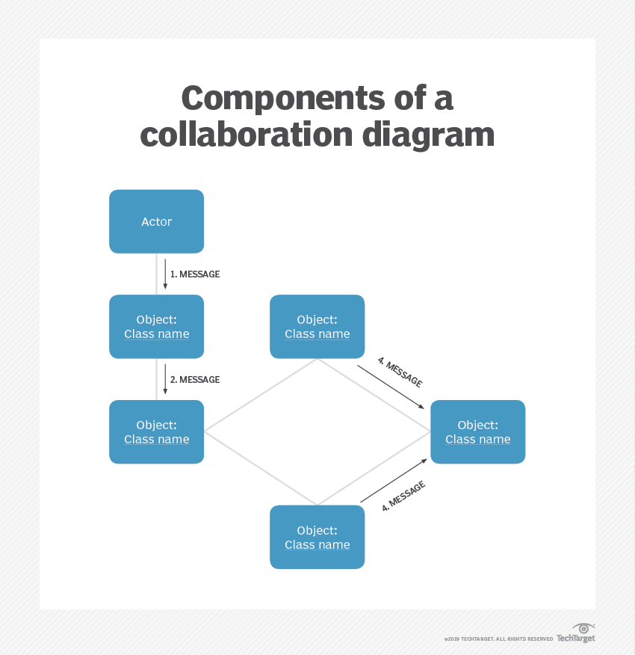

Slide 30
A component diagram
A component diagram displays the structural relationship of components of a software system.
These are mostly used when working with complex systems with many components. Components communicate with each other using interfaces. The interfaces are linked using connectors.

Slide 31
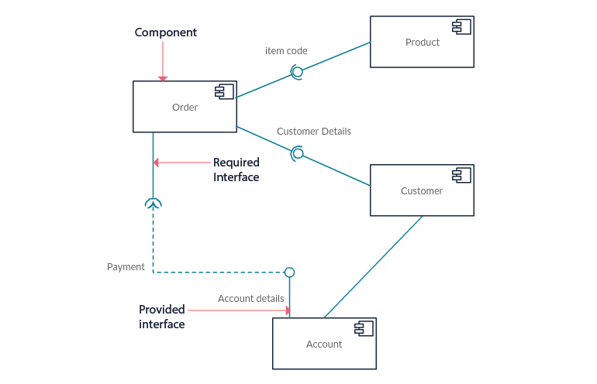

Slide 32

A data-flow diagram
A data-flow diagram (DFD) is a way of representing a flow of a data of a process or a system (usually an information system). The DFD also provides information about the outputs and inputs of each entity and the process itself. A data-flow diagram has no control flow, there are no decision rules and no loops.

